Slide 1


Slide 2
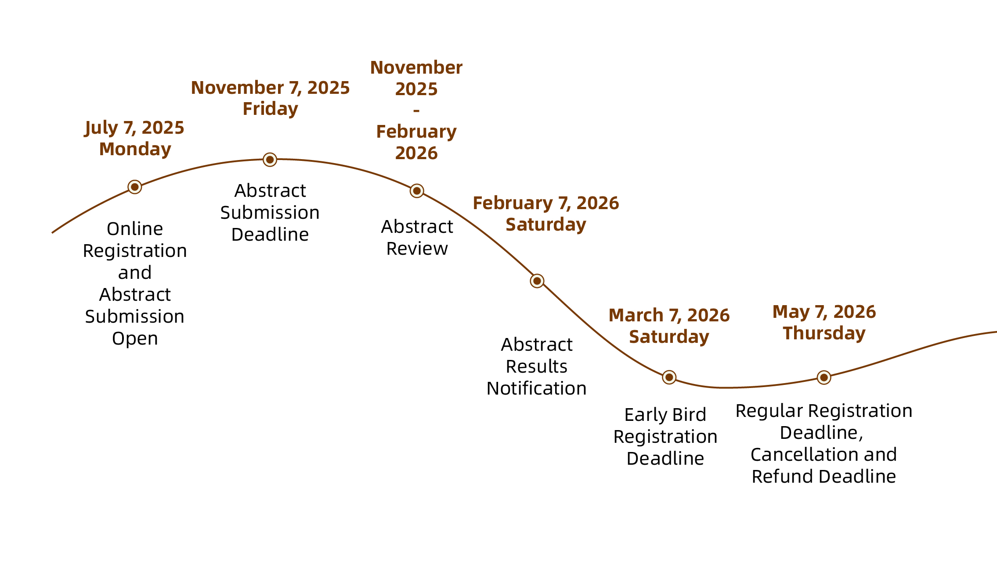
23rd WCSS-Introduction
The 23rd WCSS will be held in Nanjing International Expo Center from June 7 to 12, 2026. Held once every four years, the congress is known as the “Olympics”of international soil science community. Its inaugural landing in China in 2026 marks not only a milestone in WCSS’s century journey in soil science, but also presents a key opportunity for global scholars to engage in dialogues around the theme of “Soils and the Shared Future for Humanity”.
1
2
This congress has received strong support from the State Council, the Chinese Academy of Sciences, the Ministry of Agriculture and Rural Affairs, the China Association for Science and Technology, and the Nanjing Municipal People’s Government.
3
It is expected to welcome 4,000 participants, comprising around 1,500 international representatives and 2,500 domestic representatives. In May 2025, the congress has received more than 130 session proposals, and in July, it opened global registration and abstract submission.

Slide 3
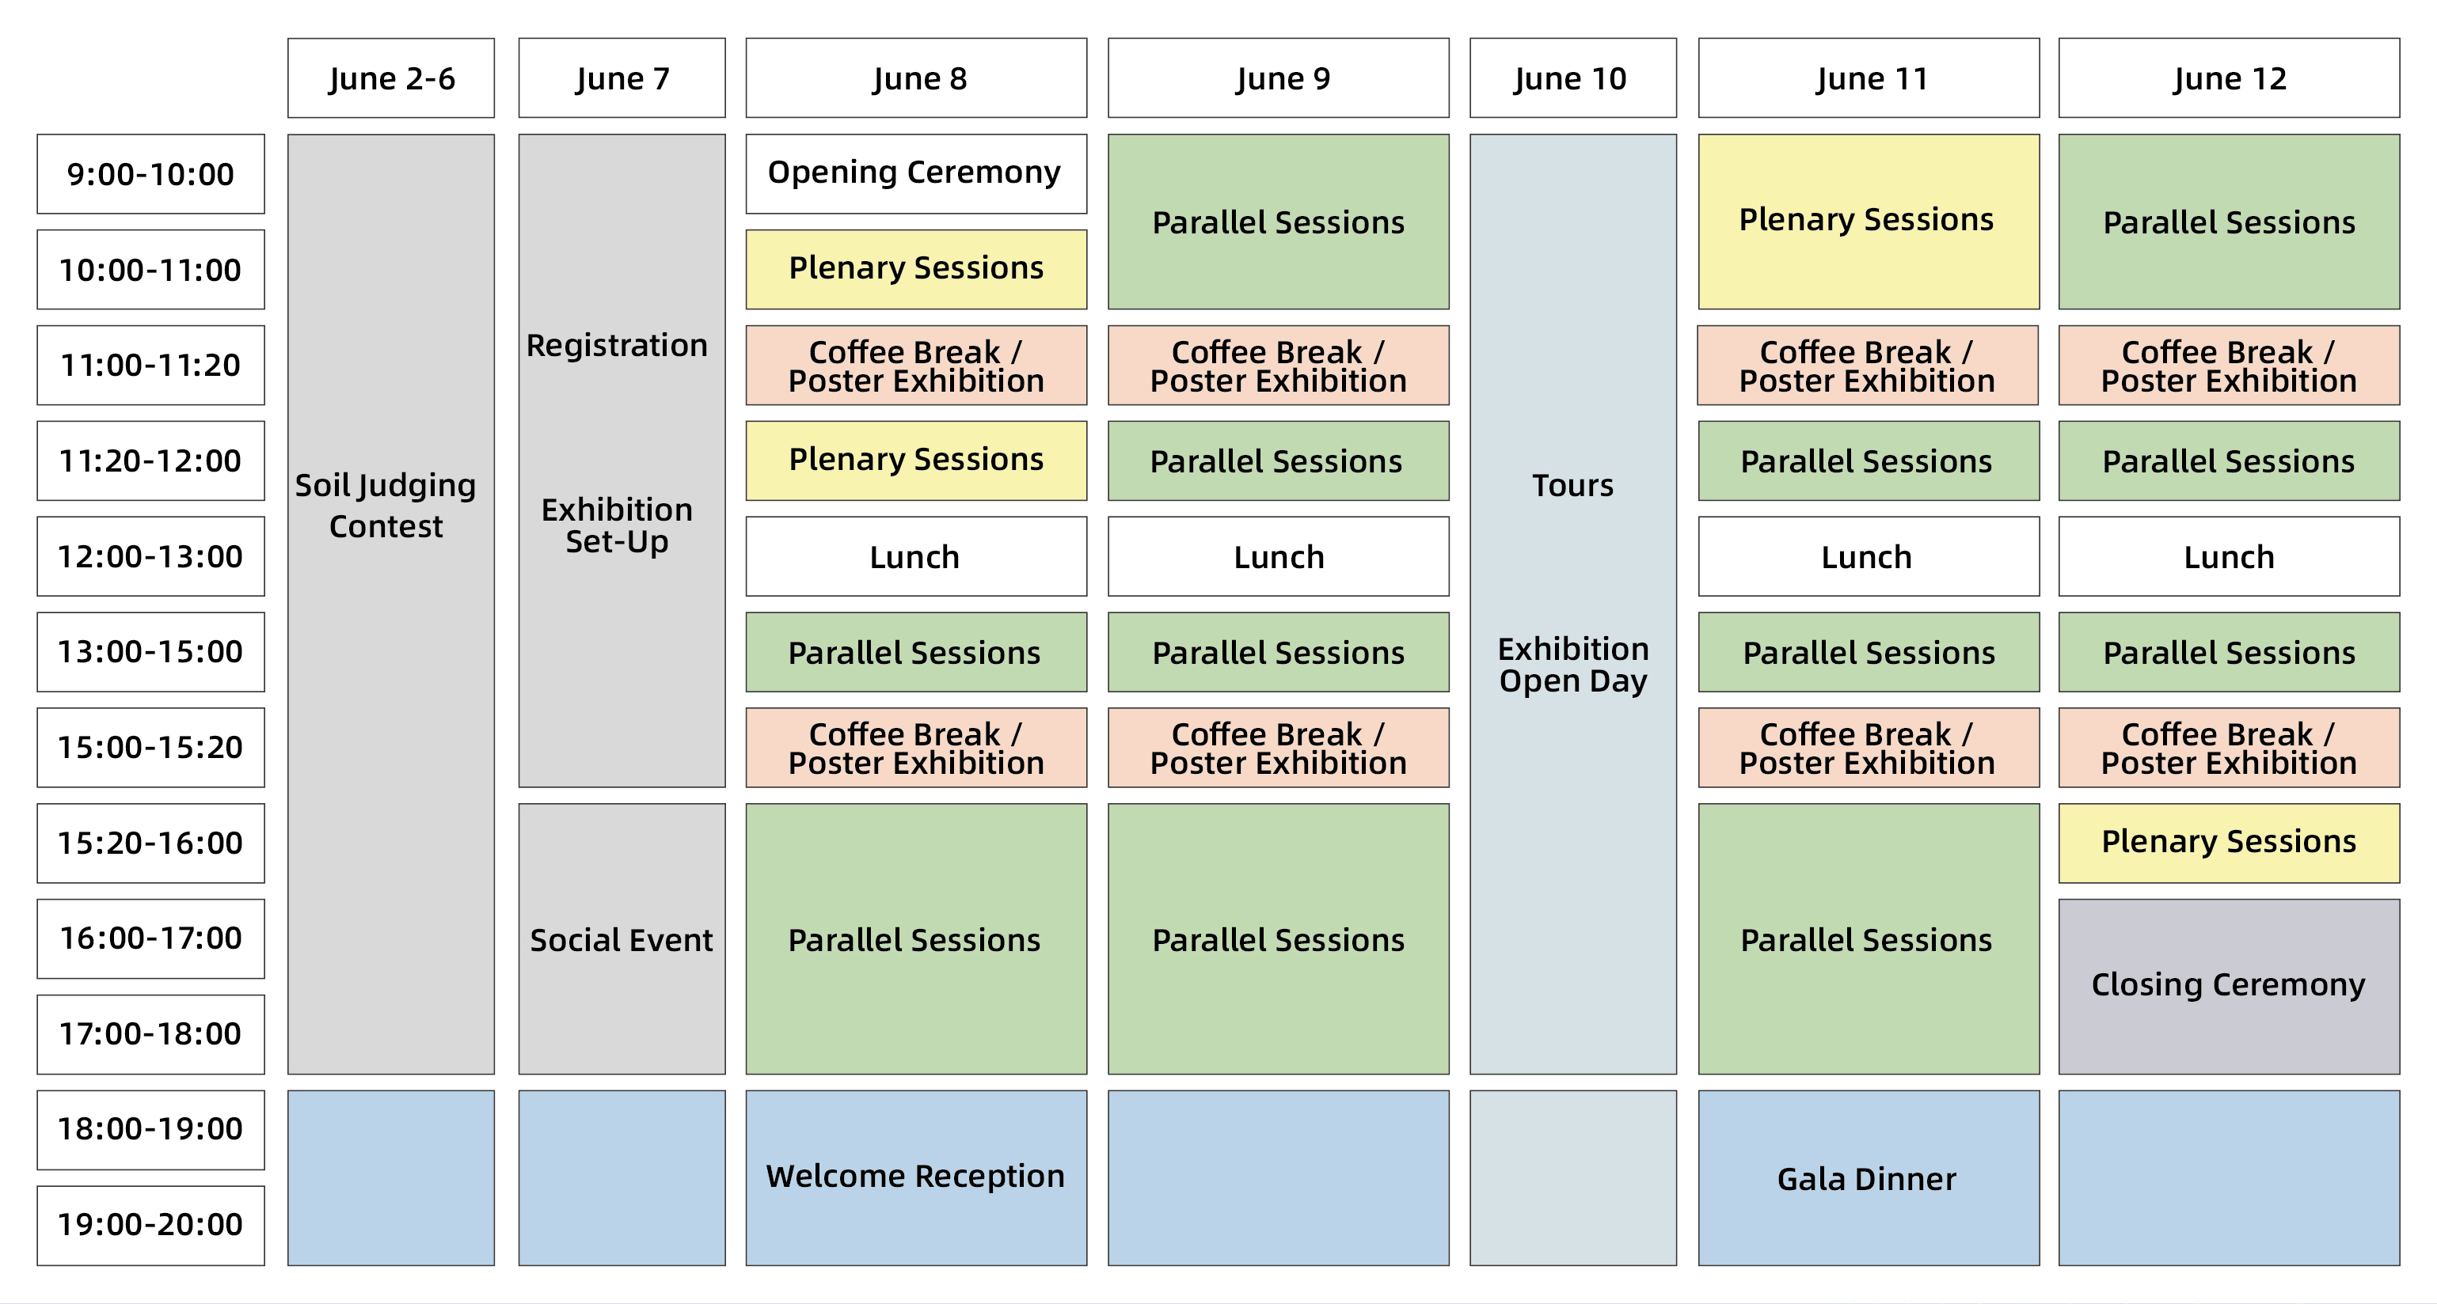
23rd WCSS-Program

